Slide 1
Assessment of Data Analysis
and Problem Solving Skills
Forbes' Highest Paid Athletes Dataset (1990-2020)
-Alisha Verma

Slide 2

Objective
The presentation showcases the results of data analysis and problem-solving using the Forbes' highest paid athletes dataset.
Plotting various graphs to analyze and catch patterns using Power BI.
Laying forth the findings from Task 1 and Task 2, highlighting unique patterns and top-paying athletic categories.

Slide 3
Overview
Any sports enthusiast knows that analyzing data is a big part of the experience. Be it cricket or car racing. But data analysis in sports is now taking teams far beyond old-school sabermetrics and game performance.
So how exactly does data analysis help?
Sports is just another field into which we can incorporate our analytical and logical abilites to analyse data and predict interesting results.
Data analytics seeks to assist decision-makers in sporting teams make better decisions directed toward increased growth and profitability.
Analysts may also help teams to get valuable information from the data and practise them to enhance the performance of the team.

Slide 4
Data Visualization
What do we mean by Data Visualization and how does it help us?
Data visualization is the graphical representation of information and data in a graphical format(Example: charts, graphs, and maps). Data visualization tools provide an accessible way to see, understand and analyse trends, patterns in data, and outliers. Data visualization tools and technologies are essential to analyzing massive amounts of information and making data-driven decisions. General types of data visualization are Charts, Tables, Graphs, Maps.
The most important thing that data visualization does is discover the trends in data. It is definitely faster to gather some insights from the data using data visualization rather than just studying a chart.
Let’s see a simple example with the data provided for the tasks:

Slide 5
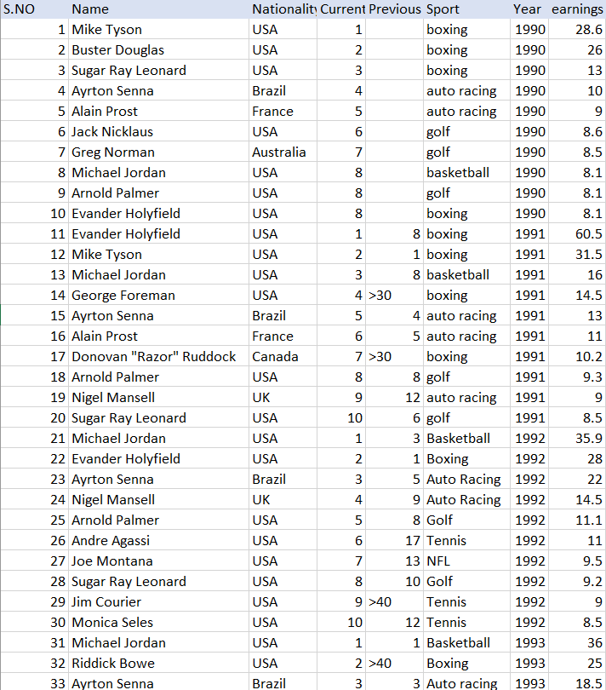
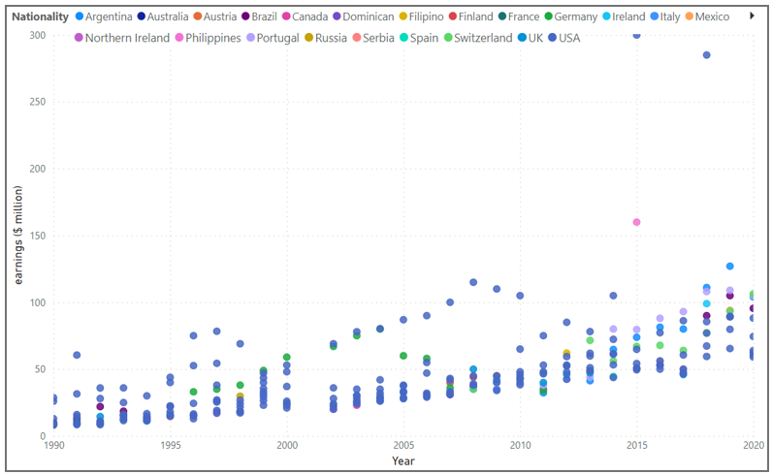
For instance: A part of a large Dataset making it difficult for us to estimate in which year earnings were maximum for a country vs a neat comprehensive visual data representation for the same:

Slide 6
Problem solving Approach:
Step 1: Data Examination and Preparation We initiated by meticulously cleaning our dataset. Highlighting the significance of consistent and well-organized data for ensuring precise outcomes.
Step 2: Grouping and Aggregation The various columns emerged as the linchpin for categorizing athletes based on their athletic disciplines and nationality etc. Then calculated and plotted the average earnings for each category using appropriate mathematical formulas. Using Power BI to plot all types of required data visualizations do required calculations.
Step 3: Sorting and Selection The subsequent stage involved sorting the categories in order based on average earnings. Our final goal is to pinpoint the top 5 categories harboring athletes with the highest average earnings.

Slide 7
Data-Driven Decisions:
Utilizing Objective Data: Anchoring the analysis in objective data, consciously sidestepping assumptions or personal biases for an unbiased outcome.
Evidence-Based Insights: The analysis hinged on interpreting tangible earnings data, furnishing us with insights firmly rooted in factual evidence.
Minimizing Bias: This recourse to a data-driven approach acted as a buffer against potential biases stemming from subjective judgments.
Emphasis on Accuracy:
Verifiable Conclusions: Conclusions drawn from data-driven analysis are inherently verifiable, offering support to every conclusion resulted from the dataset.
Eliminating Guesswork: The Methodology used excised guesswork, relying instead on rigorous quantitative analysis.

Slide 8
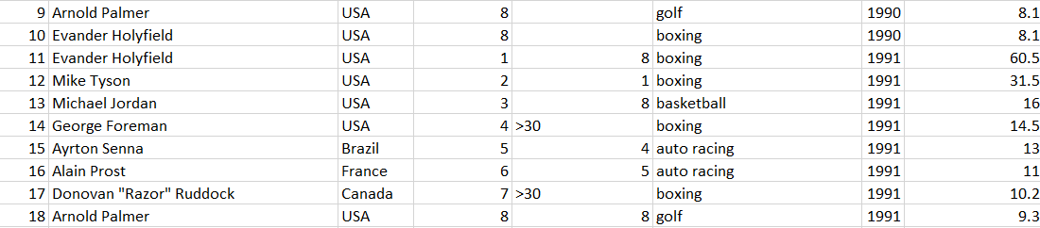
Data Preparation and Cleaning
Why do we need to clean the data? ~ Cleaning and formatting the data is required to ensure consistency. ~ Addressing missing or corrupted values for ensuring data accuracy.
Importing the entire dataset of Forbe's highest paid athletes from 1990-2020: (https://docs.google.com/spreadsheets/d/1kEBwHUrAaRrysL0o5oHDXyiHZLmnj3Wx/edit#gid=57182323)
As can be clearly seen that there are missing values and non specified numeric data, these needed to be taken care by either ejecting the entire block of data and using constant values for the latter or by feeding other appropriate data in its place:

Slide 9

Findings and result, alongwith supported
Data visuals

Slide 10
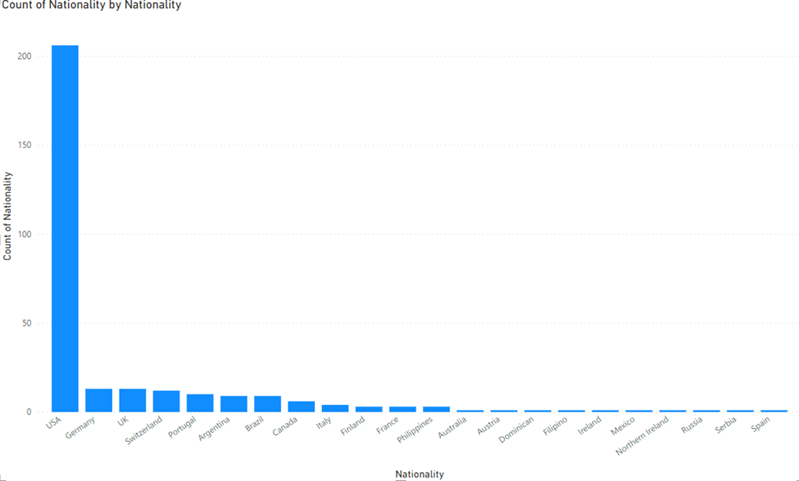
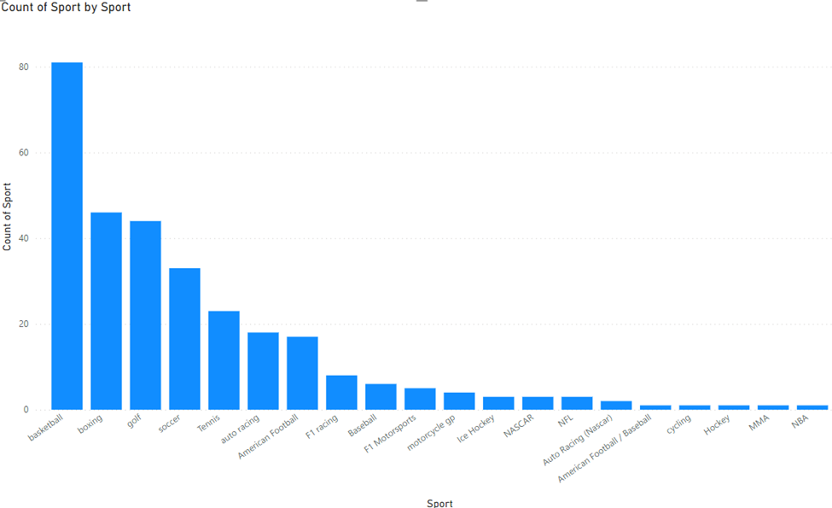
Task 1: Identifying and Analyzing Patterns
Without further ado let’s present the analysis report:
Firstly understanding source of majority of earnings:
Country for most players and sports most players are seen in the dataset:

Slide 11
Plot of earnings of different countries over the years:
It’s clearly evident that top 3 most earning countries are USA, Philippines and Argentina in last 6 years data:

Slide 12
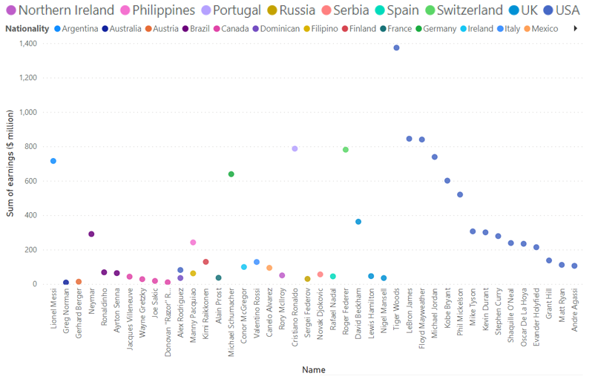
Plot of maximum and sum of earnings of different players:
It’s evidently seen that top 5 most earning players could be concluded as Floyd Mayweather, Manny Pacquiao, Tiger Woods, Cristiano Ronaldo, and Lionel Messi:

Slide 13
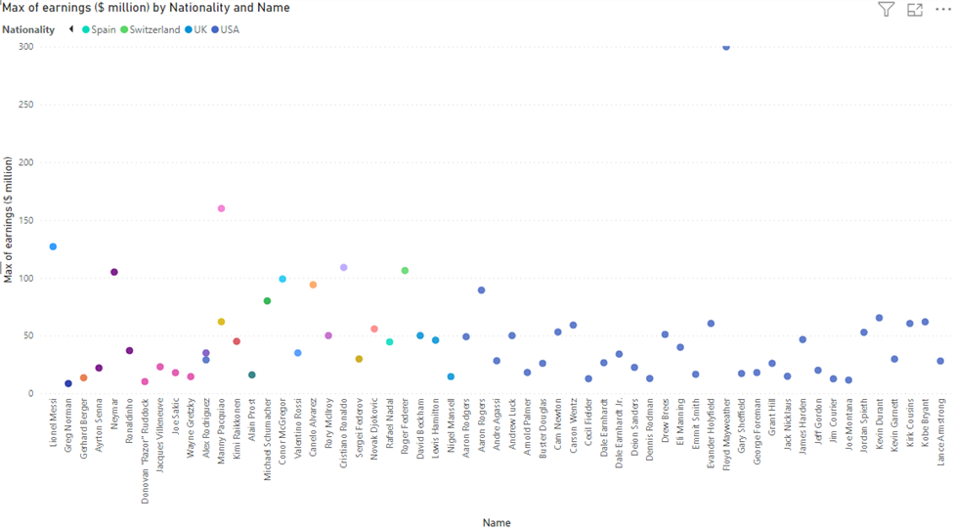
Plot of maximum and sum of earnings of different players:
It’s evidently seen that top 5 most earning players could be concluded as Floyd Mayweather, Manny Pacquiao, Tiger Woods, Cristiano Ronaldo, and Lionel Messi:

Slide 14
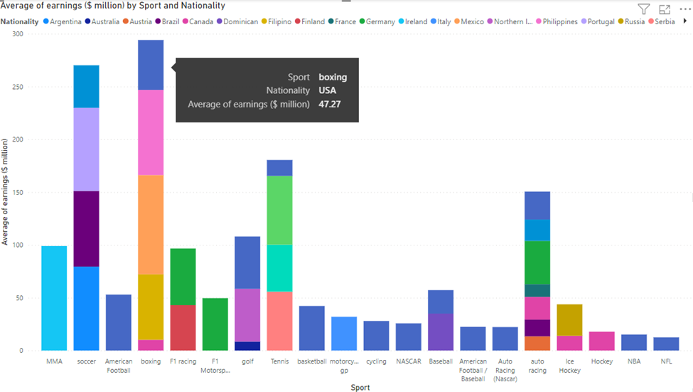
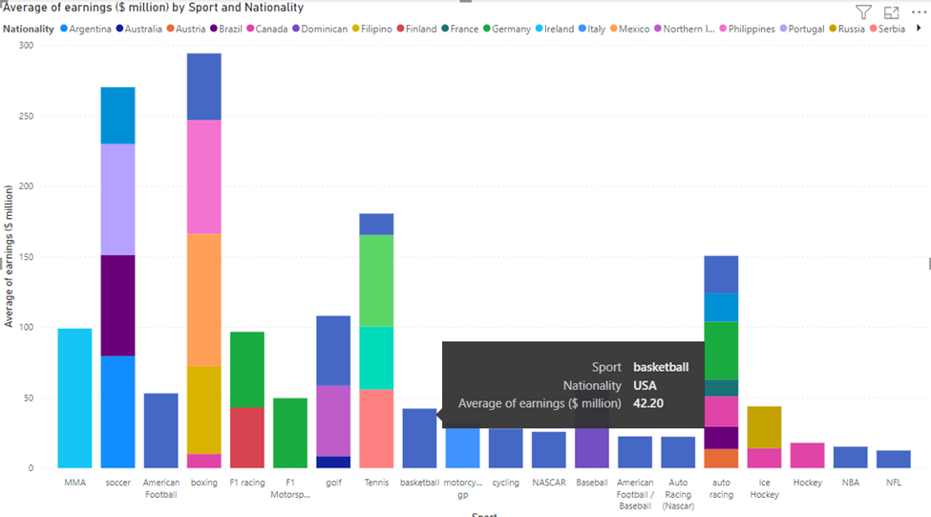
Plot of maximum, sum and average of earnings of different countries in different sports:
~ It can be comprehensibly seen that top 5 most earning countries could be concluded as USA, Argentina, Portugal, Germany and Switzerland, as these countries are common among the top few in all the graphs presented. ~ The most entertained sports can be observed as Basketball, Boxing, Golf, Tennis, Soccer and Auto Racing, since these sports can be seen to be either giving highest earnings for a player or highest sum in a particular sport.

Slide 15
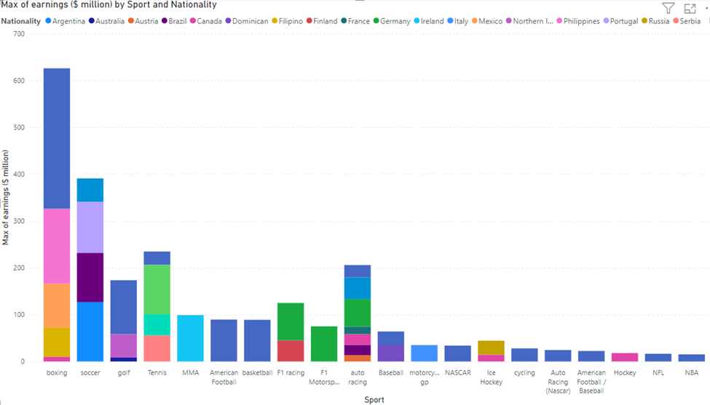
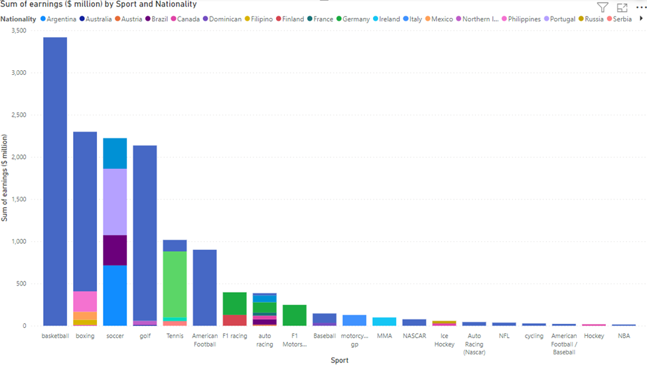
Plot of maximum, sum and average of earnings of different countries in different sports:
~ It can be comprehensibly seen that top 5 most earning countries could be concluded as USA, Argentina, Portugal, Germany and Switzerland, as these countries are common among the top few in all the graphs presented. ~ The most entertained sports can be observed as Basketball, Boxing, Golf, Tennis, Soccer and Auto Racing, since these sports can be seen to be either giving highest earnings for a player or highest sum in a particular sport.

Slide 16
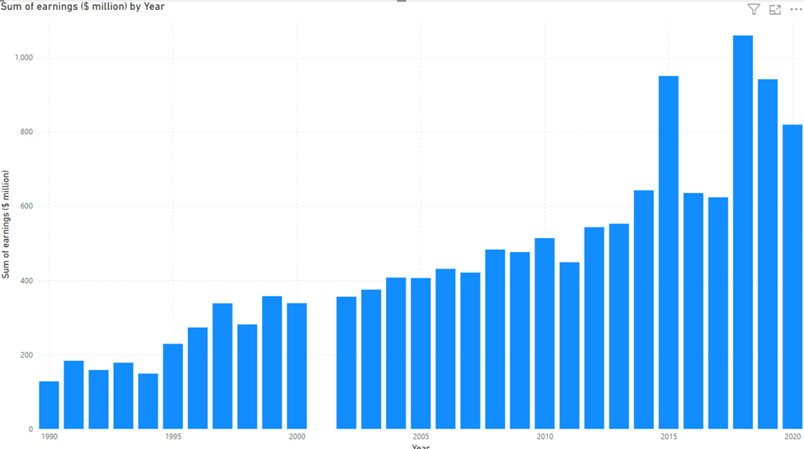
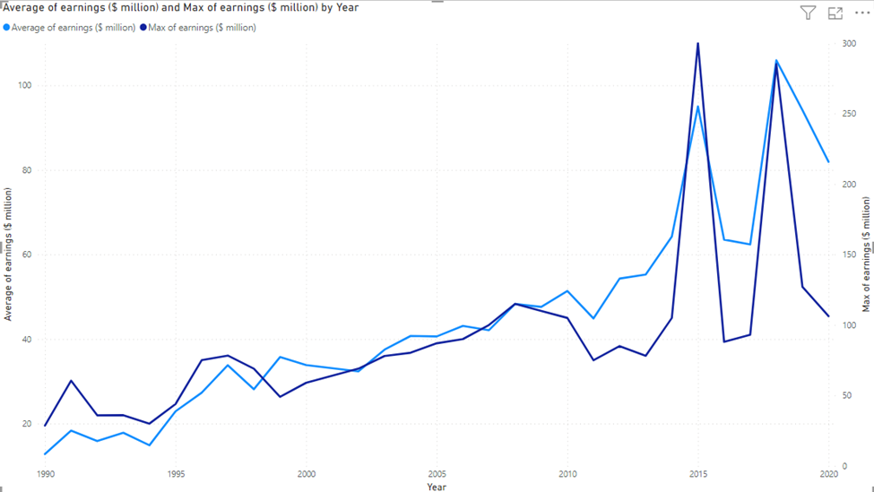
Plot of maximum and sum of earnings over the years:
~Plainly, it can be seen that earnings made, have continuously increased over the years and this trend is common in max, average and sum of earnings ~Although for one year the data was missing, as seen, and in year 2015 and 2018 there have been sharp peaks in terms of money earned, which from other graphs can be said to be contributed by mainly sports like boxing and soccer respectively;

Slide 17
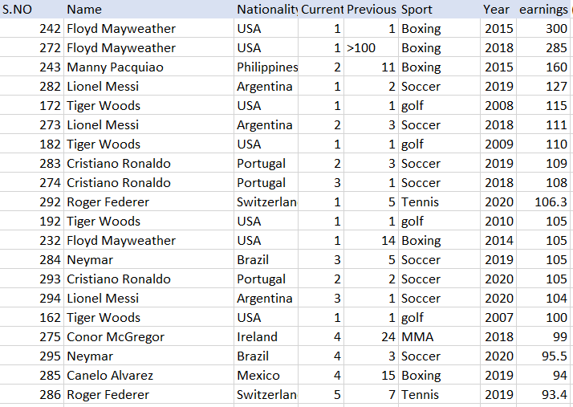
Task 2: Identifying top athletic categories
Since our entire data analysis was done in Task 1, thus understanding and identifying atleast top 5 athletic categories in which the athletes are paid the highest shouldn’t take any time at all.
Let’s take the raw data from tabulated dataset; top 20 highest earning per year/player:
If we observe, these all players are at the top, mostly ranked 1/2/3, and having a very high earning.

Slide 18
As is apparently visible whichever categories/names/sports/year were deduced from data analysis, most of them fit in the most earning category just about right, to summarize:
Players: Floyd Mayweather, Manny Pacquiao, Tiger Woods, Cristiano Ronaldo, and Lionel Messi.
Nationality: U.S.A., Argentina, Portugal, Switzerland and Germany.
Athletic categories: Basketball, Boxing, Golf, Tennis, Soccer and Racing.
Duration: 2015 to 2020 (last 5-6 years).

Slide 19

Conclusion and Submission
In conclusion, the analysis of the Forbes' highest paid athletes dataset spanning from 1990 to 2020 reveals the trends, patterns and the top 5 athletic categories that have consistently yielded the highest average earnings for athletes. These categories represent a diverse range of sports, showcasing the financial success attained by athletes in these disciplines over the past three decades.
Regarding Task 1, the data visualizations presented showcase various observable patterns and trends. In Task 2, the analysis determined the top 5 athletic categories to be basketball, boxing, golf, tennis, and soccer.

Slide 20
THANK YOU!

